Slide 2
Introduction to XML
In this first lesson, Introduction to XML, you will learn to:
  Outline the features of markup languages and list their drawbacks.
  Define and describe XML.
  State the benefits and scope of XML.

Slide 3
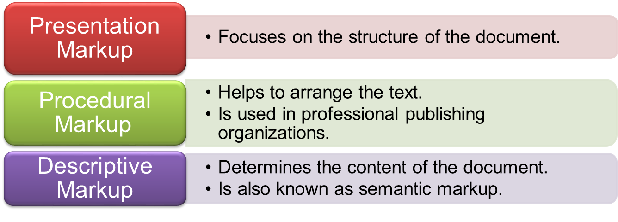
Features of Markup Languages 1-4
Markup Languages:
  Are used to define the meaning and organize the structure of a text document.
  Help the documents by giving them a new look and formatting the text.
Markup languages are categorized into the following categories:

Slide 4
Features of Markup Languages 2-4
Two types of markup languages are popular in recent times:
  Generalized Markup Languages (GML) – These type of languages describe the structure and meaning of the text in a document.
  Specific Markup Languages - These type of markup languages are used to generate application specific code.
GML was developed to accomplish the following:
  The markup should describe only the structure of the document.
  The syntax of the markup language should be strictly followed so that the code can clearly be read by a software program or by a human being.
ANSI Committee created Standard Generalized Markup Language (SGML), an all-encompassing coding scheme and flexible toolkit for developing specialized markup languages.

Slide 5
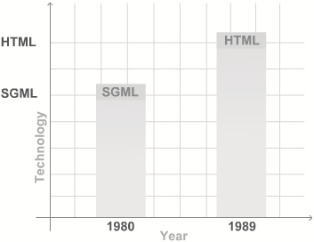
Features of Markup Languages 3-4
SGML:
  Is the successor to GML.
  Is acquired by International Organization for Standardization (ISO) as a standard.
  Is a meta language as other languages are created from it.
  Has a syntax to describe what tags are allowed in different locations.
  Consists of SGML declaration and SGML Document Type Definition (DTD).
  Was used to create to HyperText Markup Language (HTML).
Figure depicts the evolution of markup languages:

Slide 6
Features of Markup Languages 4-4
Features of earlier markup languages are:
Drawbacks of earlier markup languages are:
GML describes the document in terms of its format, structure, and other properties.
SGML ensures that the system can represent the data in its own way.
HTML used ASCII text, which allows the user to use any text editor.
GML and SGML were not suited for data interchange over the Web.
HTML possesses instructions on how to display the content rather than the content they encompass.

Slide 7
Evolution of XML
Extensible Markup Language (XML):
  Is a W3C recommendation.
  Was developed over HTML.
  Is a set of rules for defining semantic tags that break a document into parts and identify the different parts of the document.
Table lists the differences between HTML and XML.
HTML | XML
HTML was designed to display data. | XML was designed to carry data.
HTML displays data and focuses on how data looks. | XML describes data and focuses on what data is.
HTML displays information. | XML describes information.

Slide 8
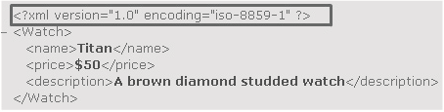
Features of XML
Figure shows an XML code.
Features of XML are as follows:
  XML stands for Extensible Markup Language.
  XML is a markup language much like HTML.
  XML was designed to describe data.
  XML tags are not predefined. You must define your own tags.
  XML uses a DTD or an XML Schema to describe the data.
  XML with a DTD or XML Schema is designed to be self-descriptive.

Slide 9
XML Markup
Defines the physical and logical layout of the document.
Divides a document into separate information containers called elements.
  Outermost element is called root element that contains other elements plus optional administrative information at the top known as XML declaration.
The code demonstrates the elements.
where,
  <Name>, <Price>, <Description> and <Number> inside the tags are elements.
  <FlowerPlanet> and </FlowerPlanet> are the root elements.
Snippet
<?xml version="1.0" encoding="iso-8859-1" ?>
- <FlowerPlanet>
<Name>Rose</Name>
<Price>$1</Price>
<Description>Red in color</Description>
<Number>700</Number>
</FlowerPlanet>

Slide 10
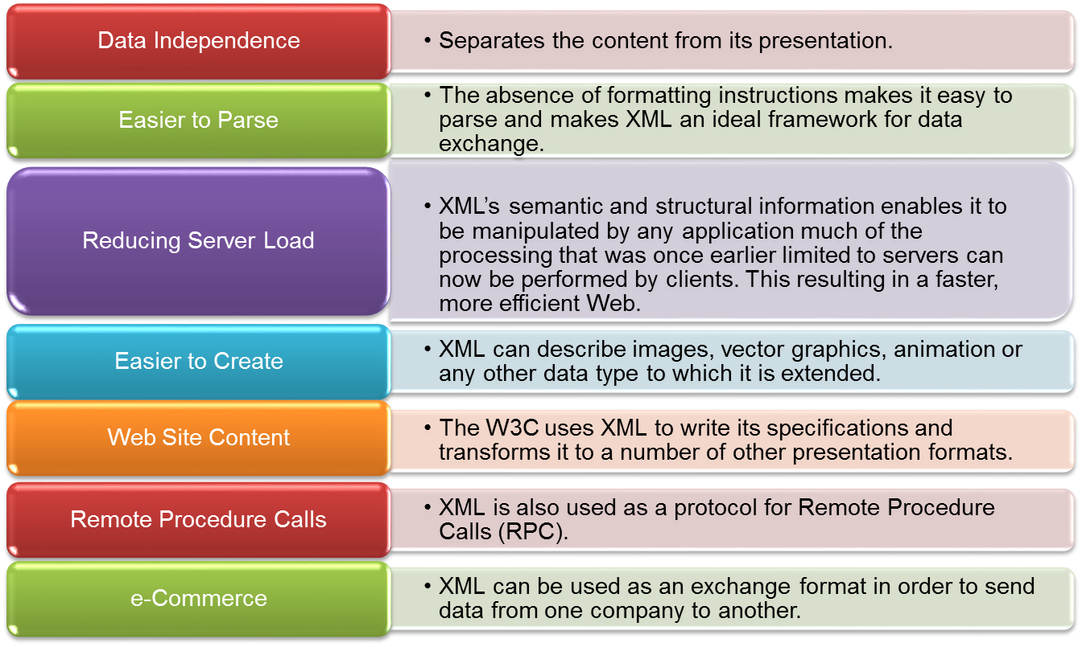
Advantages and Disadvantages of XML 1-2
Benefits of XML are as follows:

Slide 11
Advantages and Disadvantages of XML 2-2
Some of the disadvantages are as follows:
  Usage of XML leads to increase in data size and processing time.
  XML lacks adequate amount of processing instructions.
  XML is more demanding and difficult as compared to HTML.
  XML is verbose and wordy as the tags used in it are predefined.
  Versions of Internet Explorer (IE) earlier than 5.0 do not support XML.

Slide 12
Exploring XML
In this second lesson, Exploring XML, you will learn to:
  Describe the structure of an XML document.
  Explain the lifecycle of an XML document.
  State the functions of editors for XML and list the popularly used editors.
  State the functions of parsers for XML and list names of commonly used parsers.
  State the functions of browsers for XML and list the commonly used browsers.

Slide 13
XML Document Structure 1-3
XML documents are commonly stored in text files with extension .xml.
XML document contains two sections that are:
Document Prolog: Document prolog contains metadata and consists of two parts:
  XML Declaration: It specifies the version of XML being used.
  Document Type Declaration: It defines entities’ or attributes’ values and checks grammar and vocabulary of markup.
Root Element: Root element is also called a document element. It must contain all the other elements and content in the document.

Slide 14
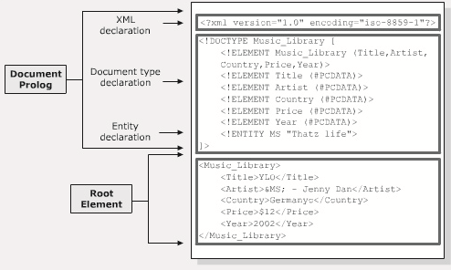
XML Document Structure 2-3
Following are some of the relationships:
  Parent: It is an element that contains other elements.
  Child: It is an element that is present within another element.
  Sibling: They are elements which have the same parent element.
  Nesting: It is a process where an element contains other elements.
Figure shows the XML document structure.

Slide 15
XML Document Structure 3-3
The code demonstrates the XML document structure.
The first block indicates xml declaration and document type declaration. Music_Library is the root element.
Snippet
<?xml version="1.0" encoding="iso-8859-1"?>
<!DOCTYPE Music_Library [
<!ELEMENT Music_Library (Title,Artist,Country,Price,Year)>
<!ELEMENT Title (#PCDATA)>
<!ELEMENT Artist (#PCDATA)>
<!ELEMENT Country (#PCDATA)>
<!ELEMENT Price (#PCDATA)>
<!ELEMENT Year (#PCDATA)>
<!ENTITY MS "Thatz life">
]>
<Music_Library>
<Title>YLO</Title>
<Artist>&MS; - Jenny Dan</Artist>
<Country>Germany</Country>
<Price>$12</Price>
<Year>2002</Year>
</Music_Library>

Slide 16
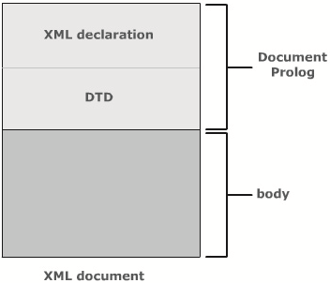
Logical Structure
The logical structure of an XML document:
  Gives information about the elements.
  Order in which they are to be included in the document.
  Shows how a document is constructed rather than what it contains.
Figure shows the logical structure of XML document.
  XML Declaration and Document Type Definition are its two basic and optional components
  Document Prolog forms the basis of the logical structure of the XML document.
Code for XML declaration: <?xml version="1.0" encoding="iso-8859-1" ?>
Code of a DTD: <!DOCTYPE Music_Library SYSTEM "Mlibrary.dtd">

Slide 17
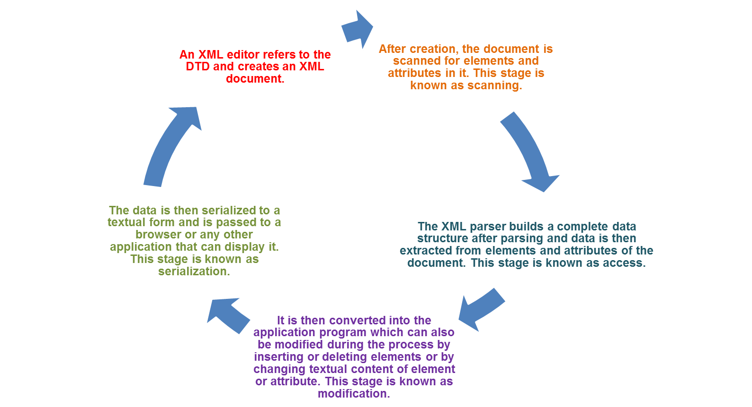
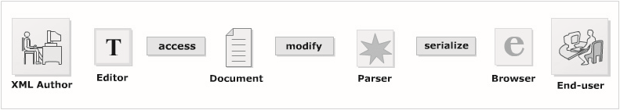
XML Document Life Cycle
Figure displays the XML document life cycle.

Slide 18
Editors 1-2
An XML Editor is used to create and edit XML documents.
As XML documents are text-based markup languages, a standard Windows Notepad or Wordpad can also be used.
The main functions that editors provide are as follows:
  Add opening and closing tags to the code.
  Check for validity of XML.
  Verify XML against a DTD/Schema.
  Perform series of transforms over a document.
  Color the XML syntax.
  Display the line numbers.
  Present the content and hide the code.
  Complete the word.

Slide 19
Editors 2-2
The popularly used editors are:
  XMLwriter
  XML Spy
  XML Pro
  XMLmind
  XMetal

Slide 20
Parsers 1-2
An XML parser/XML processor reads the document and verifies it for its well-formedness.
An XML parser keeps the entire representation of XML data in memory with the help of Document Object Model (DOM).
The in-built parser used in IE 5.0 is also known as Microsoft XML Parser (MSXML).
MSXML:
  Supports some of the COM objects for backward interoperability.
  Supports XSL transformations, which contain data manipulation operations.
  Specifies a data type for the element or the attribute.
  Improves the performance of the applications with the help of different caching features.

Slide 21
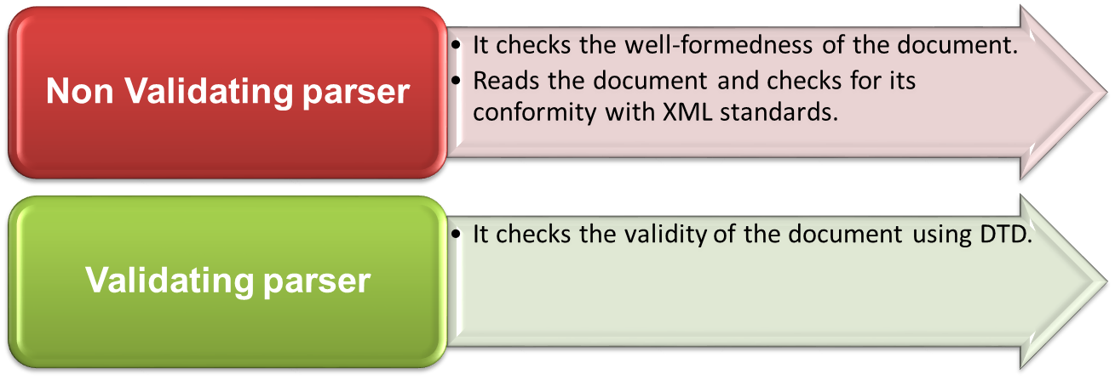
Parsers 2-2
Commonly used parsers are:
  Crimson
  Xerces
  Oracle XML Parser
  JAXP (Java API for XML)
  MSXML
The two types of parsers are:

Slide 22
Browsers
After the XML document is read, the parser passes the data structure to the client application, Web browser.
Browsers:
  Formats the data and displays it to the user.
Other programs like database, MIDI program or a spreadsheet program may also receive the data and present it accordingly.
Commonly used Web browsers are as follows:
  Netscape
  Mozilla
  Internet Explorer
  Firefox
  Opera

Slide 23
Working with XML
In this third lesson, Working with XML, you will learn to:
  Explain the steps towards building an XML document.
  Define what is meant by well-formed XML.

Slide 24
Creating an XML Document 1-2
An XML document has three main components:
  Tags (markup) and text (content).
  DTD or Schema.
  Formatting or display specifications.
The steps to build an XML document are as follows:
  Create an XML document in an editor
    To create a simple XML document, you type XML code in any text or XML editor as demonstrated in the code.
Snippet
<?xml version="1.0" encoding="iso-8859-1"?>
<Soft_drink>
<Name>Refresh</Name>
<Price>$1</Price>
</Soft_drink>

Slide 25
Creating an XML Document 2-2
  Saving the XML file
    To save the file, you click the File menu, click the Save option and provide the file name such as, for example, SoftDrink.xml.
  Load XML document in a browser
    After the document is saved, you can open the file directly in a browser that supports XML. A common browser used is Internet Explorer 5.0 or later.

Slide 26
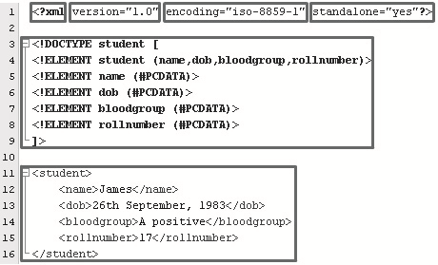
Exploring the XML Document 1-2
The various building blocks of an XML document are as follows:
  XML Version Declaration.
  Document Type Definition.
  Document instance in which the content is defined by the markup.
Figure depicts a XML document.
  <?xml - Indicates that the document is an XML document.
  version="1.0“ - Tells the version of XML, the type of character encoding being used and the markup declaration used in the XML document.
  encoding="iso-8859-1" - Characters are encoded using various encoding formats.
  standalone="yes“ - Indicates the presence of external markup declarations. "Yes" indicates that there are no external markup declarations and "no" indicates that external markup declarations might exist.

Slide 27
Exploring the XML Document 2-2
The Document Type Declaration declares and defines the elements used in the document class, as demonstrated in the code.
If the same DTD is used externally, then the code is:
Snippet
<!DOCTYPE Student [
<!ELEMENT Student (Name,Dob,BloodGroup,RollNumber)>
<!ELEMENT Name (#PCDATA)>
<!ELEMENT Dob (#PCDATA)>
<!ELEMENT BloodGroup (#PCDATA)>
<!ELEMENT RollNumber (#PCDATA)>
]>
Snippet
<!DOCTYPE student SYSTEM "studatabase.dtd">
<Student>
<Name>James</Name>
<Dob>26th September, 1983</Dob>
<BloodGroup>A positive</BloodGroup>
<RollNumber>17</RollNumber>
</Student>

Slide 28
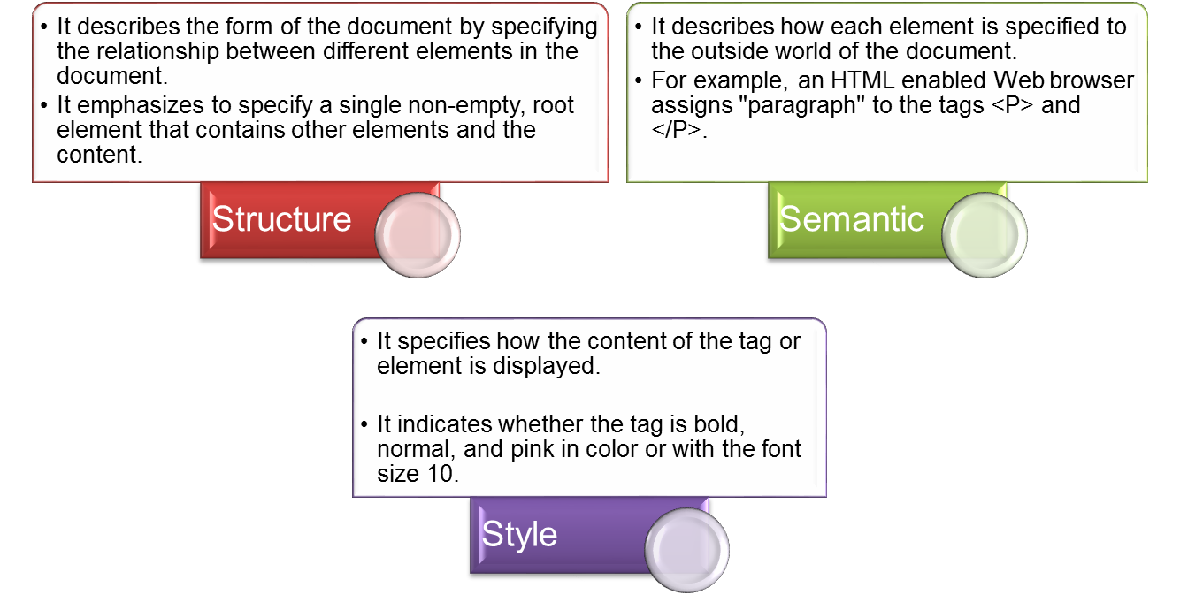
Meaning in Markup
Markup can be divided into the following three parts:

Slide 29
Well-formed XML Document 1-3
Well-formedness refers to the standards that are to be followed by the XML documents.
Well-formedness makes XML processors and browsers read XML documents.
Well-formedness fulfills the following rules:
  Minimum of one element is required: Every well formed XML document should consists of a minimum of one element.
  XML tags are case sensitive: All the tags used are case sensitive, that is <URGENT> is different from <urgent>.
  Every start tag should end with end tag: All the tags in XML should begin with a start tag and a matching end tag. The end tags only have an additional forward slash as compared to their start tag.
  XML tags should be nested properly: All the XML tags used should be nested properly. The code demonstrates this property.
Snippet
<Book>
<Name>Good XML</Name>
<Cost>$20</Cost>
</Book>

Slide 30
Well-formed XML Document 2-3
  XML tags should be valid
    Should begin with letter, an underscore (_), or a colon (:).
    Should contain combination of letters, numbers, periods (.), colons, underscores, or hyphens (-).
    Should not contain white space.
    Should not start with reserved words such as "xml".
  Length of markup names
    The length of the tags depends on the XML processors.
  XML attributes should be valid
    Attributes should not be duplicated.
    Attributes are specified by a name and value pair which is delimited by equal (=) sign. The values are delimited by quotation marks. For example,
      <DOLL NAME = "BARBIE" COLOR = "PINK">
    Attributes should follow the same rules as followed by tags.
  XML documents should be verified
    To be read by the XML browsers, the document should be checked against the XML rules.

Slide 31
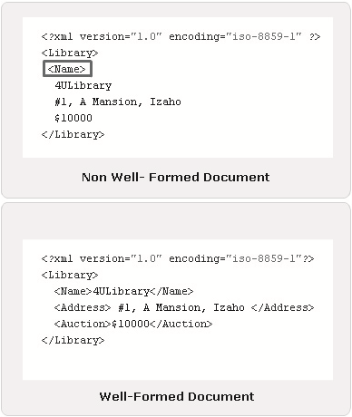
Well-formed XML Document 3-3
Figure shows a well-formed XML document.

Slide 32
XML Syntax
In this last lesson, XML Syntax, you will learn to:
  State and describe the use of comments and processing instructions in XML.
  Classify character data that is written between tags.
  Describe entities, DOCTYPE declarations and attributes.

Slide 33
Comments 1-2
Are used for the people to give information about the code in the absence of the developer.
Makes a document more readable.
Are not restricted to document type definitions but may be placed anywhere in the document.
Are similar to those in HTML.
Are used only for human consumption rather than machine consumption.
Are not parsed.
Are inserted into the XML document and are not part of the XML code.
Can appear in the document prolog, DTD or in the textual content.
Start with the string <!-- and end with the string -->.

Slide 34
Comments 2-2
Rules to be followed while writing comments:
  Comments should not include "-" or "—" as it might lead to confuse the XML parser.
  Comments should not be placed within a tag or entity declaration.
  Comments should not be placed before the XML declaration.
  Comments can be used to comment the tag sets.
  Comments cannot be nested.
  The code demonstrates the comments.
Snippet
<!-- Highlight these
<ChiefGuest1> King </ChiefGuest1>
<Judge>Queen</Judge>
-->

Slide 35
Processing Instructions
Are information which is application specific.
Do not follow XML rules or internal syntax.
Are passed to the application which can either use the processing instructions or pass them on to another application.
Must begin with <? and end with ?>.
  where,
  PITarget is the name of the application that should receive the processing instructions.
  <instruction> is the instruction for the application.
The code demonstrates an example of processing instruction.
Syntax
<?PITarget <instruction>?>
Snippet
<Name NickName=’John’>
  <First>John</First>
  <!--John is yet to pay the term fees-->
  <Last>Brown</Last>
  <?feesprocessor SELECT fees FROM STUDENTFEES?>
  <Semester>Final</Semester>
</Name>

Slide 36
Classification of Character Data
An XML document is divided into markup and character data.
Character data:
  Describes the document’s actual content with the white space.
  Text in character data is not processed by the parser and thus, not treated as a regular text.
  Can be classified into:
    CDATA
    PCDATA

Slide 37
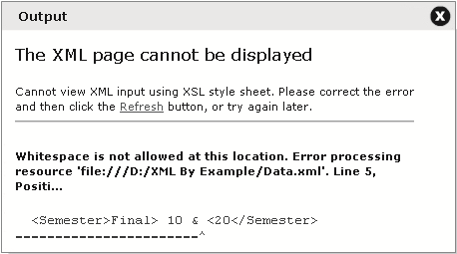
PCDATA 1-2
The data that is parsed by the parser is called as parsed character data (PCDATA).
PCDATA :
  Specifies that the element has parsed character data. It is used in the element declaration.
  Is used in the element declaration.
Escape character such as "<" when used in the XML document will make the parser interpret it as a new element and will generate an error as shown in the figure.

Slide 38
PCDATA 2-2
The code demonstrates an example of PCDATA.
Snippet
<Name nickname=’John’>
  <First>John</First>
  <!--John is yet to pay the term fees-->
  <Last>Brown</Last>
  <Semester>Final> 10 & <20</Semester>
</Name>

Slide 39
CDATA
Stands for character data that has reserved and white space characters in it.
Is not parsed by the parser, it is commonly used for scripting code.
Indicates to the parser that it is just a text but not a markup.
Always begins with the delimiter <![CDATA[ and ends with the delimiter ]]>.
The code demonstrates an example of CDATA.
Syntax
<![CDATA[ data ]]>
Snippet
<Sample>
  <![CDATA[
  <Document>
  <Name>Core XML</Name>
  <Company>Aptech</Company>
  </Document>]]>
</Sample>

Slide 40
Entities 1-3
The XML document is made up of large amount of information called as entities.
Entities:
  Are used to avoid typing long pieces of text repeatedly, within the document.
  Can be categorized into the following:
    Character entities: These entities can also be used with decimal or hexadecimal values with a condition that the numbers support Unicode coding. These are replaced with their equivalent characters by XML processing.
    Content entities: These entities are used to replace certain values. They are similar to text substitution macros in programming languages such as C. Format : <!Entity name value>
    Unparsed entities: These entities when used, turn off the parsing process. They can be used to include multimedia content in the XML document.

Slide 41
Entities 2-3
  An entity reference consists of an ampersand (&), the entity name, and a semicolon (;).
  Must be declared before they are used in the document.
  Can be declared either in a document prolog or in a DTD.
  Table lists entities that are defined in the system and are known as pre-defined entities.
Predefined Entity | Description | Output
&lt; | Produces the left angle bracket | <
&gt; | Produces the right angle bracket | >
&amp; | Produces the ampersand | &
&apos; | Produces a single quote character | ‘
&quot; | Produces a double quote character | "

Slide 42
Entities 3-3
The code demonstrates an example of entities.
Snippet
<?xml version="1.0"?>
<!DOCTYPE Letter [
<!ENTITY address "15 Downing St Floor 1">
<!ENTITY city "New York">
]>
<Letter>
<To>&quot;Tom Smith&quot;</To>
  <Address>&address;</Address>
  <City>&city;</City>
<Body>
  Hi! How are you?
  The sum is &gt; $1000
</Body>
<From>ARNOLD</From>
</Letter>

Slide 43
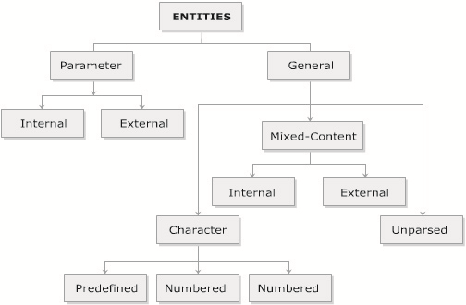
Entity Categories 1-3
Entities are used as shortcuts to refer to the data pages.
Figure shows the entity categories.

Slide 44
Entity Categories 2-3
The two types of entities are as follows:
  General Entity
    Are the entities used within the document content.
    Can either be declared internally or externally.
    Start out with an ampersand (&) and end with a semicolon (;).
    Is defined in the DTD and declared with the keyword <!ENTITY>.
    Example: <!ENTITY Name "text that is to replaced">.
    External entities refer to the storage units outside the document containing the root element and are embedded inside the document.
    Example: <!ENTITY Name SYSTEM "URL">.
    The code demonstrates an example of general entity.
Snippet
<!DOCTYPE MusicCollection [
  <!ENTITY R "Rock">
  <!ENTITY S "Soft">
  <!ENTITY RA "Rap">
  <!ENTITY HH "Hiphop">
  <!ENTITY F "Folk">
]>

Slide 45
Entity Categories 3-3
  Parameter Entity
    Are used only in the DTD.
    Should not be used in the content of the XML document as the processor does not recognise them.
    Is similar to general entity, except that it will include the % specifier.
    Are referenced by using percent-sign (%) and semicolon (;) as delimiters.
    Example: <!ENTITY % ADDRESS "text that is to be represented by an entity">.

Slide 46
Doctype Declarations 1-2
A DTD is declared to indicate what DTD the document adheres to.
A DTD can be declared either in the XML document or can be referenced to the external document.
where,
  name_of_root_element is the name of the root element.
  SYSTEM is the url where the DTD is located.
  [Internal DTD subset] are those declarations that are in the document.
Syntax
<! DOCTYPE name_of_root_element
  SYSTEM "URL of the external DTD subset" [
  Internal DTD subset
]>

Slide 47
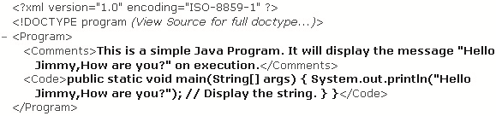
Doctype Declarations 2-2
The code demonstrates an example of document type declaration.
Output:
Snippet
<?xml version="1.0" encoding="ISO-8859-1"?>
<!DOCTYPE program SYSTEM "HelloJimmy.dtd">
<Program>
<Comments>
  This is a simple Java Program. It will display the message "Hello Jimmy,How are you?" on execution.
</Comments>
<Code> public static void main(String[] args) {
  System.out.println("Hello Jimmy,How are you?"); // Display the string.
}
}
</Code>
</Program>

Slide 48
Attributes 1-2
Are part of the elements.
Provide information about the element and are embedded in the element start-tag.
Consists of an attribute name and an attribute value.
Precedes its value, which are separated by an equal sign.
Is enclosed in the quotes to delimit multiple attributes in the same element.
Can be of CDATA, ENTITY, ENUMERATION, ID, IDREF, NMTOKEN or NOTATION.
Syntax
<?xml version="1.0" ?>
  <Player Sex="male">
  <FirstName>Tom</FirstName>
  <LastName>Federer</LastName>
</Player>

Slide 49
Attributes 2-2
Attributes have some limitations, which are as follows:
  Unlike child elements, they do not contain multiple values and do not describe structures.
  They are not expandable for future changes.
  They are not easily manipulated by the code.
  They are not easy to test against a DTD.

Slide 50
Summary
In this module, Introduction to XML, you learnt about:
  Introduction to XML
    XML was developed to overcome the drawbacks of earlier markup languages. XML consists of set of rules that describe the content to be displayed in the document. XML markup contains the content in the information containers called as elements.
  Exploring XML
    XML document is divided into two parts namely, document prolog and root element. An XML editor creates the XML document and a parser validates the document.
  Working with XML
    XML document is divided into XML Version Declaration, DTD and the document instance in which the markup defines the content. The XML markup is again categorized into structural, semantic and stylistic. The output of the XML document is displayed in the browser if it is well formed.
  XML Syntax
    Comments are used in the document to give information about the line or block of code. The content in XML document is divided into mark up and character data. The entities in XML are divided into general entities and parameter entities. A DTD can be declared either internally or externally.

